Slide 1



Energy simulation tool
Gilles Butikofer
15.12.2025
HSLU T&A, Horw​

Slide 2

Concept of the tool
Web based tool accessible via a link
Coded with python, using Streamlit library for the front end
Is hosted on the main workstation, like the recommender tool

Slide 3
Concept of the tool
Heat map mode
Understand and compare solar production depending on panels orientation
Time series mode
Performs an energy balance and shows the behaviour of key building energy components, such as energy use, costs, and CO₂ emissions over time.
User defines demands and technologies for electricity & heating at home

Slide 4

But for who ?
https://www.vecteezy.com/vector-art/5430007-boy-students-making-choices-vector-illustration-free-download

Slide 5
But for who ?
For anyone thinking about investing in one of these technologies in a building
PV
Battery
Heat pump
Fuel based heater
TES
Solar thermal collectors

Slide 6
Example of outputs

Slide 7
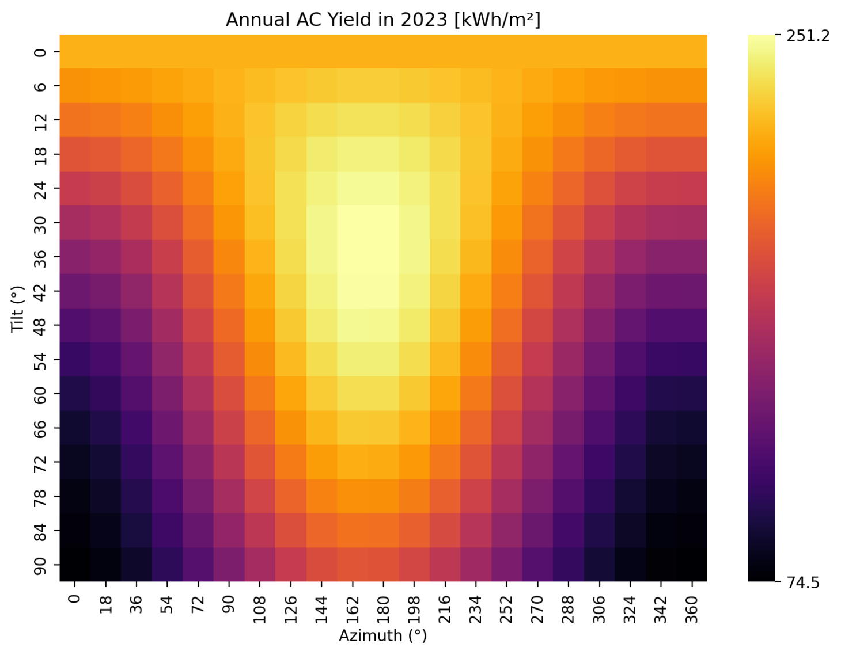
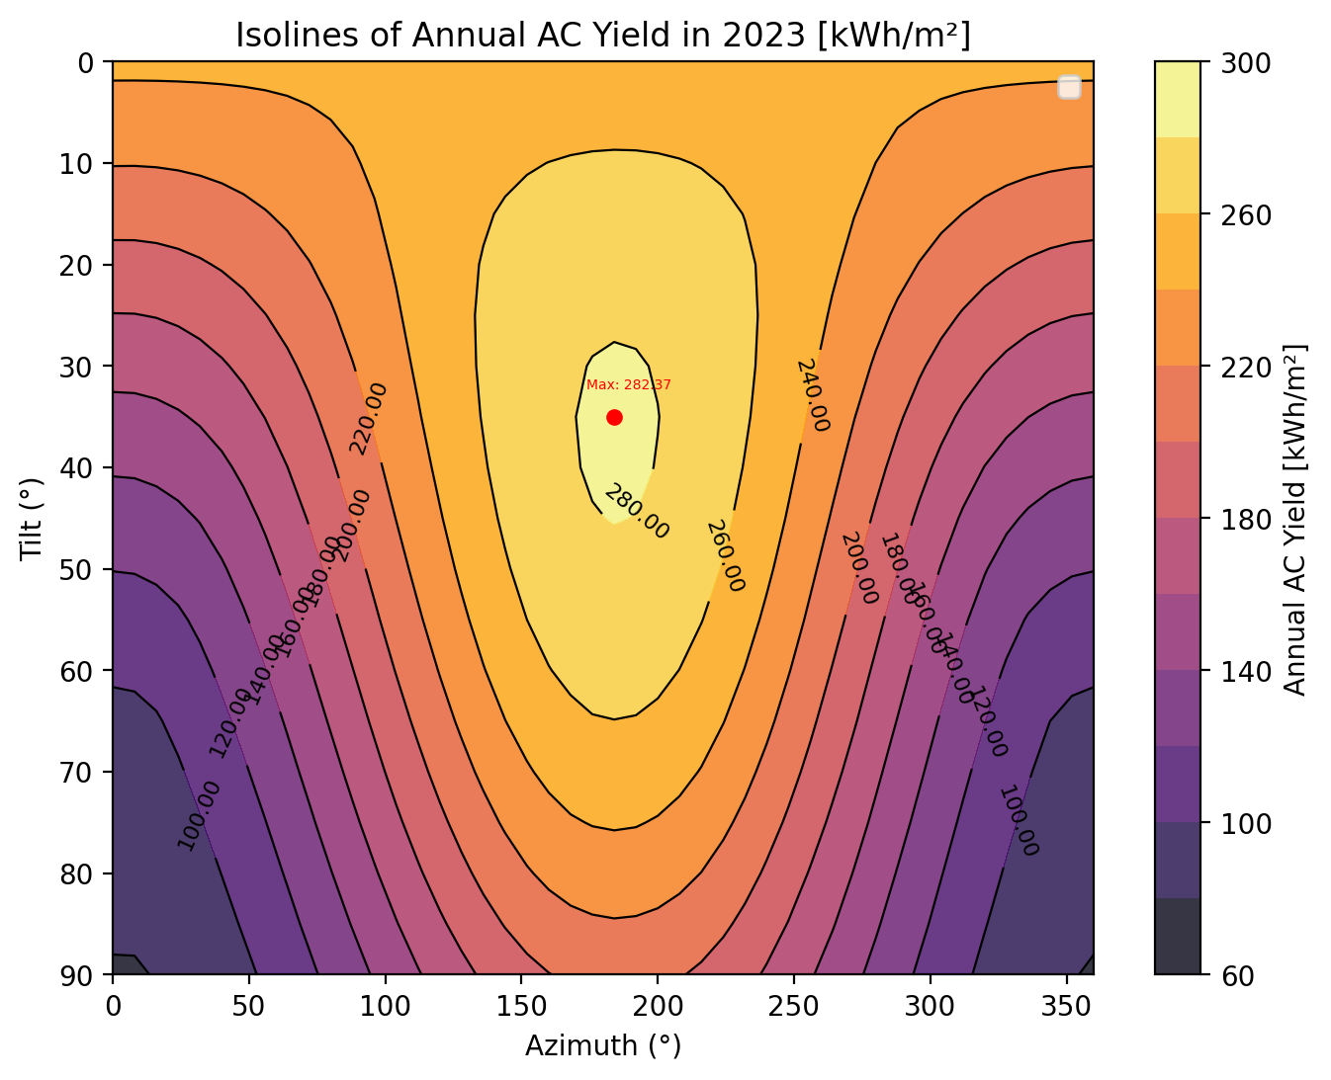
Heat map mode
Sweeps through all possible orientations and plots a heat map of each yearly production value.

Slide 8
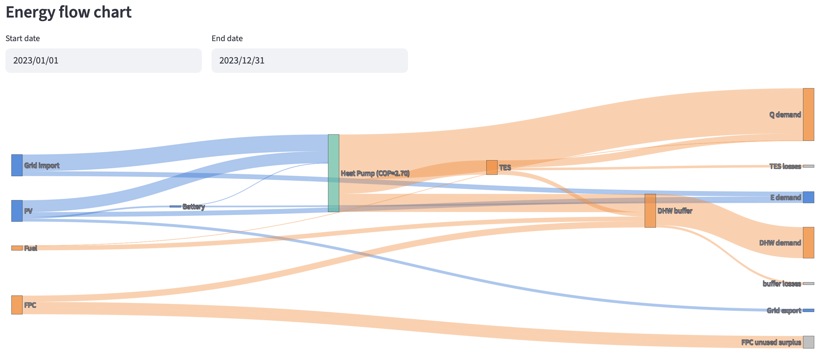
Time series mode
Time series mode: Performs an energy balance and shows the behaviour of key building energy components, such as energy use, costs, and CO₂ emissions over time.

Slide 9
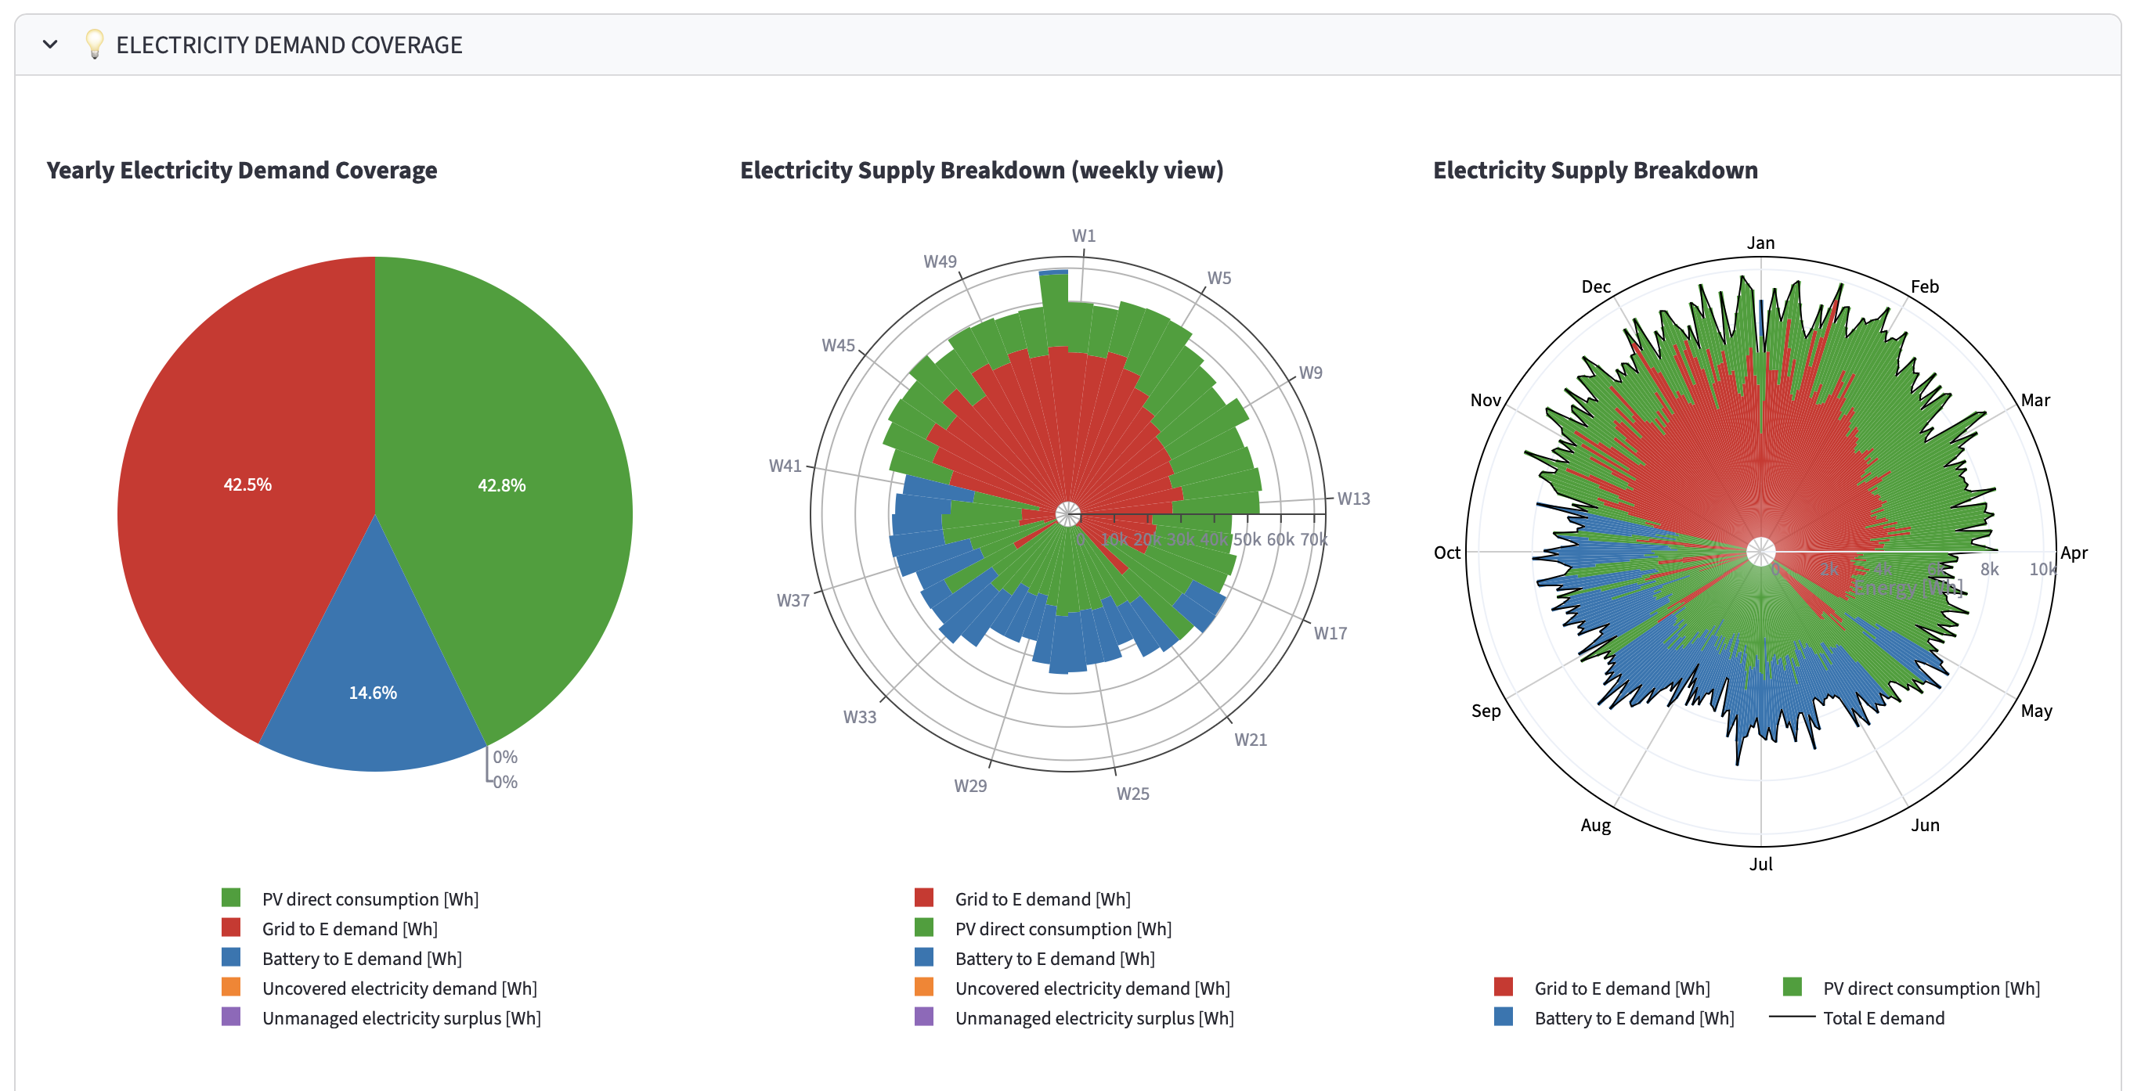
Time series mode
Example output of the electrical demand coverage

Slide 10
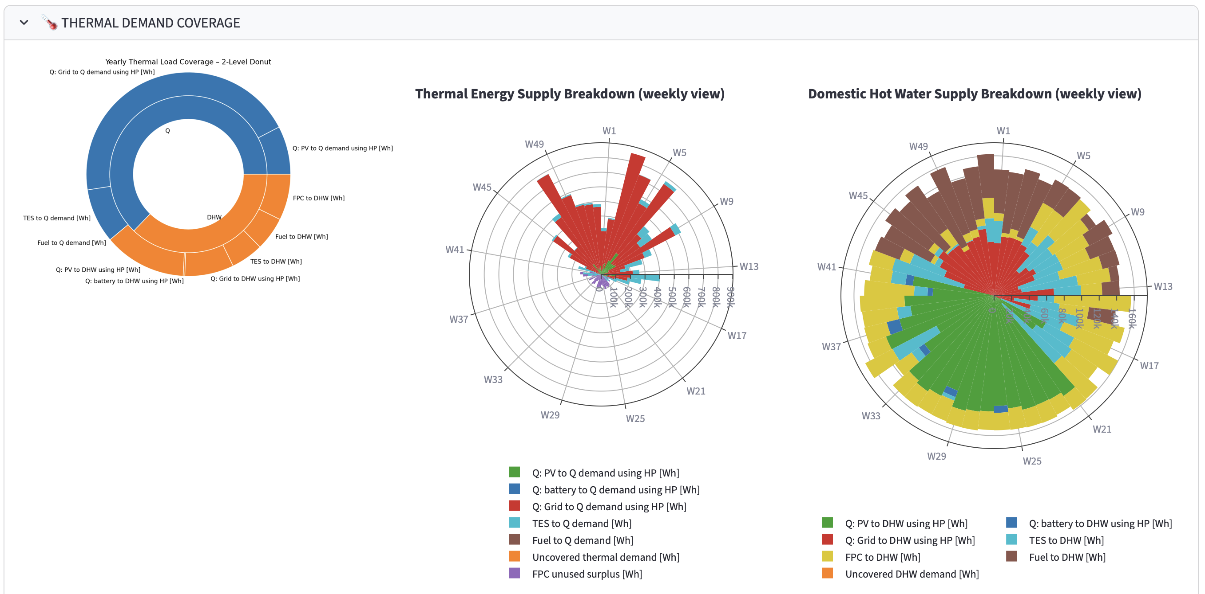
Time series mode
Example output of the thermal demand coverage

Slide 11
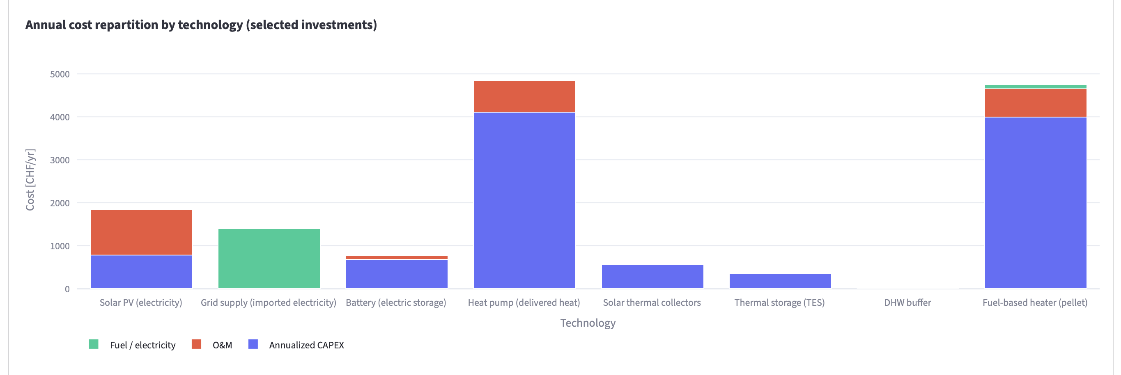
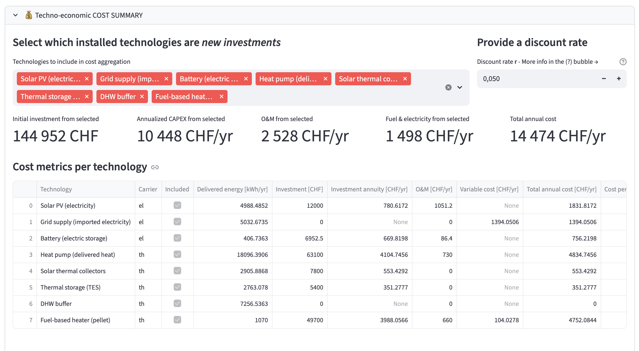
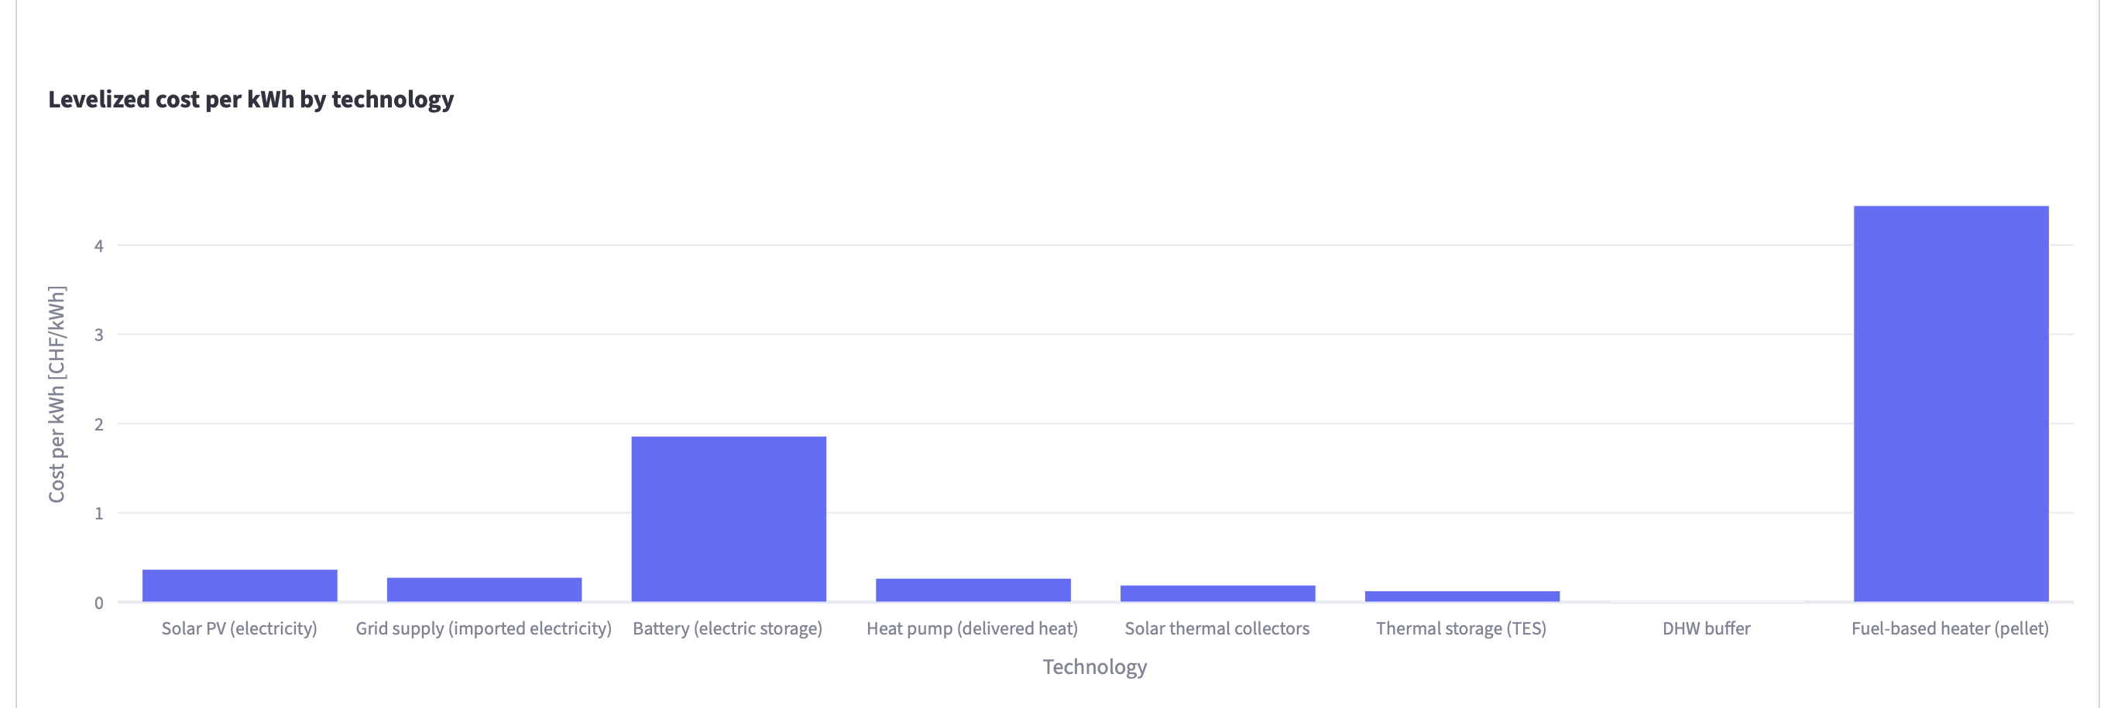
Time series mode
Example output of the cost panel

Slide 12
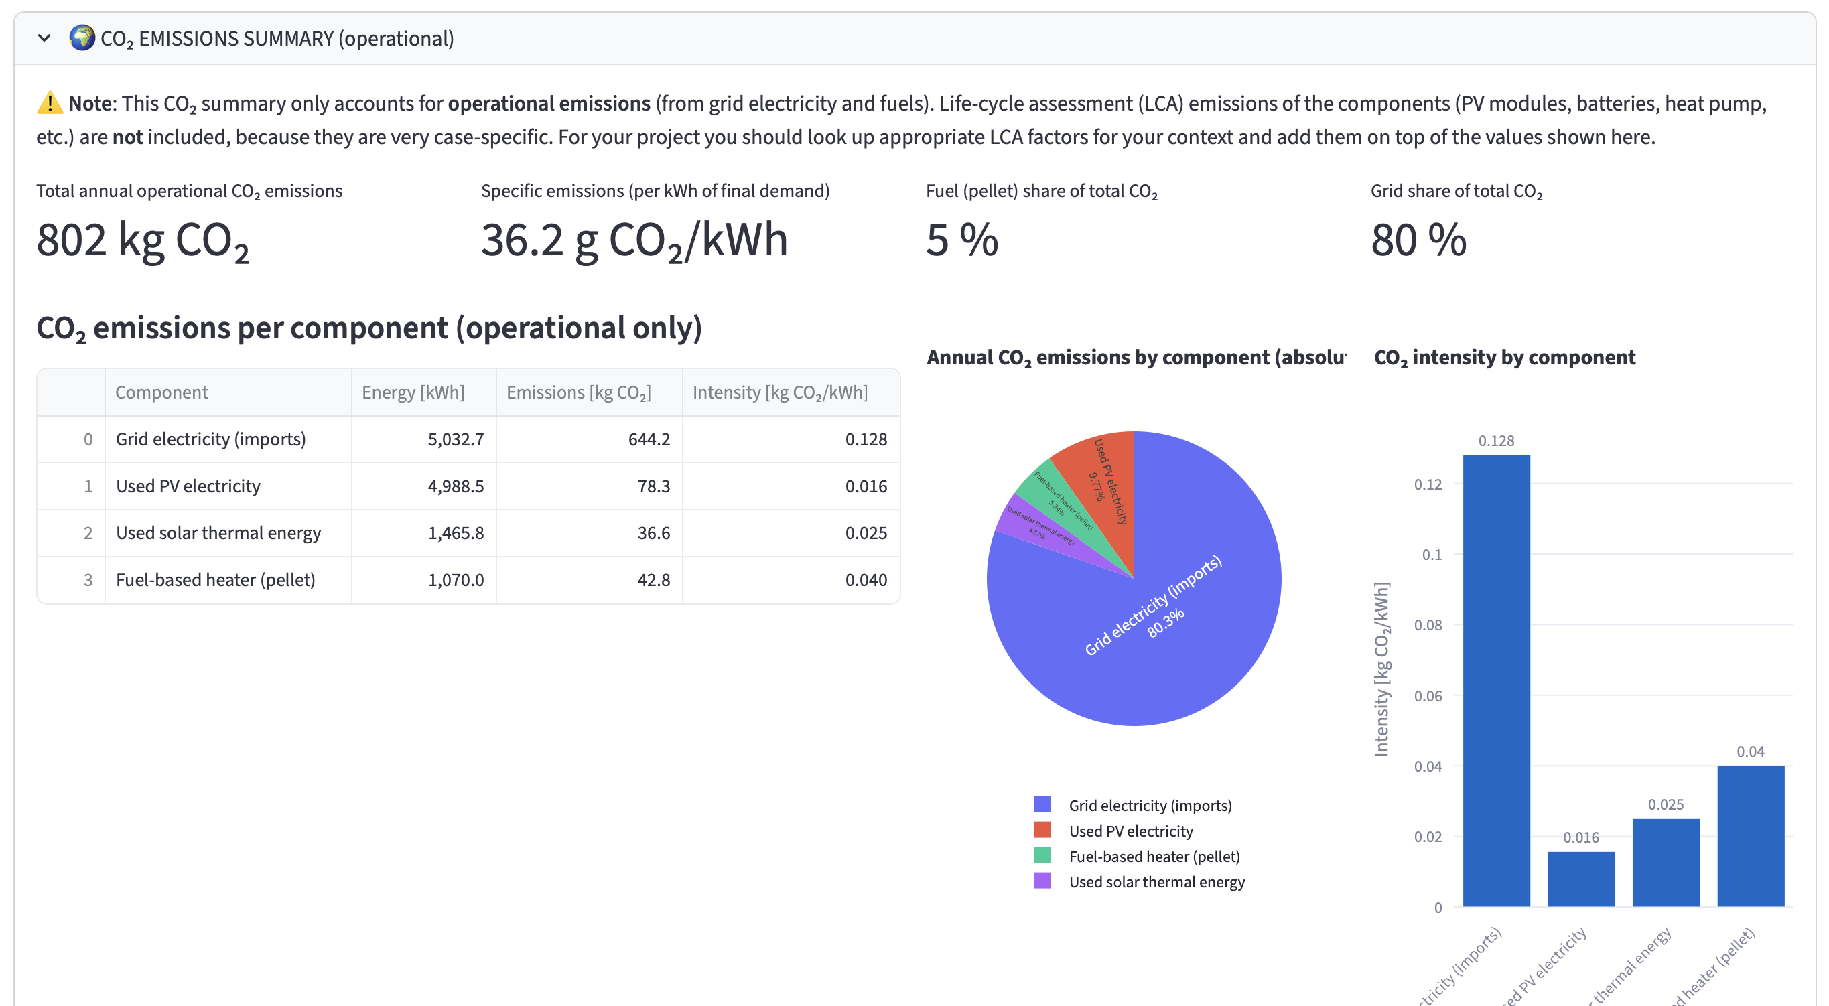
Time series mode
Example output of the CO₂ emission panel

Slide 13
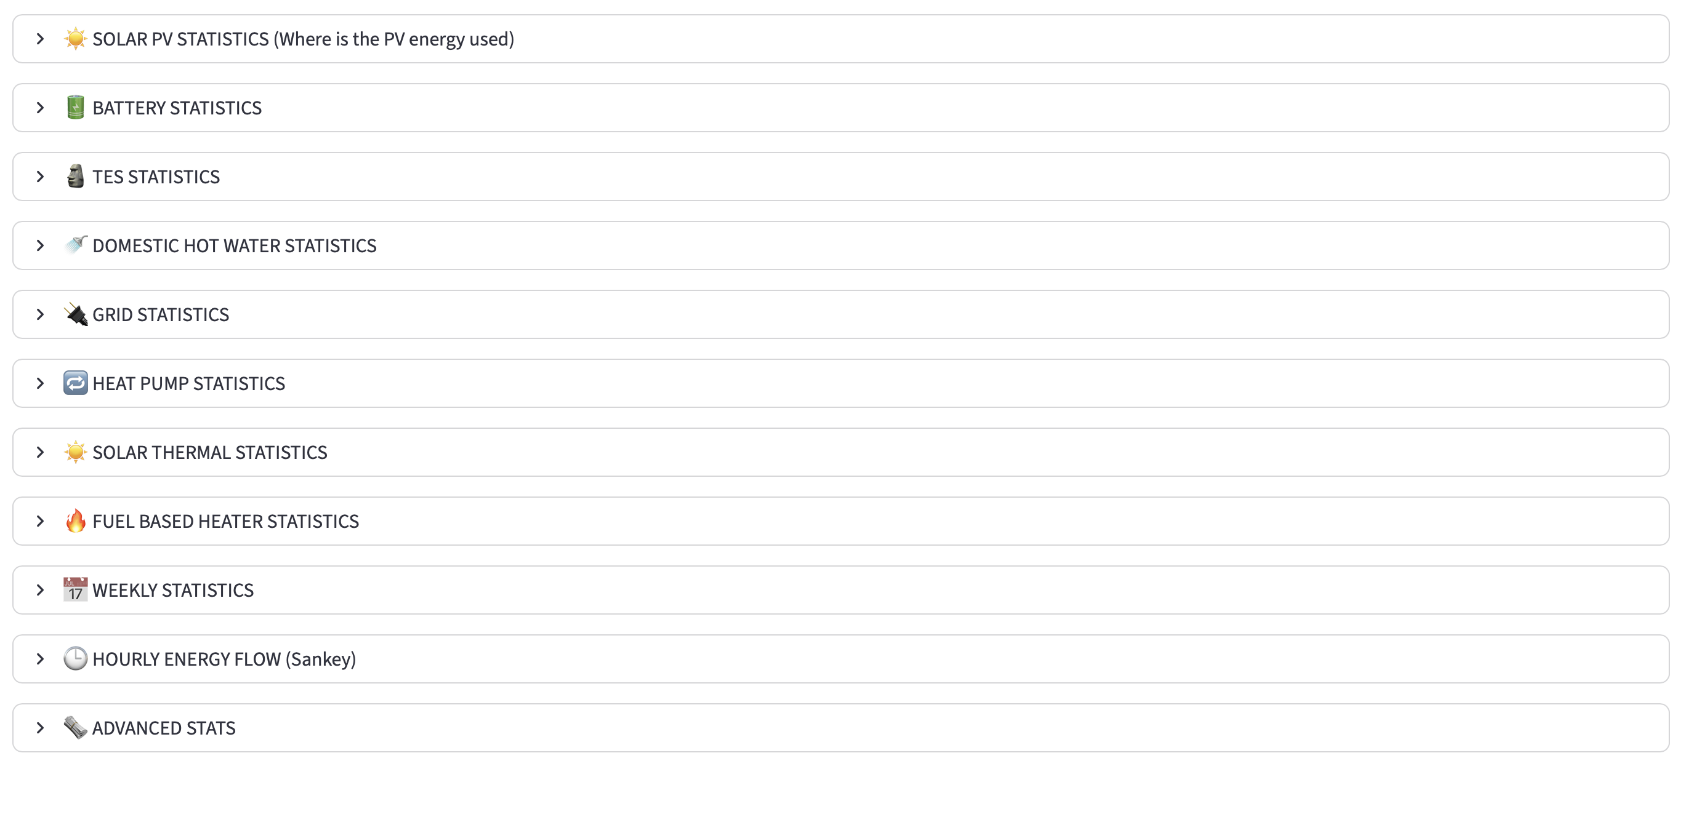
Time series mode
And many more …

Slide 14

How to use it
Available at : https://energysim.recommendertool.ch
Or via the QR code
On computer (and mobile) (would recommend a larger screen)
Code on GitHub [hidden link]

Slide 15
Data source
Cost data is using python code from Somesh reading CDB_Catalogue.xlsx
Electrical demand is a general profile is from the DEM (single or multi family home)
Thermal demand profile is based on the outdoor temperature (HDD)
DHW demand is a daily profile (SIA 385/2:2025)

Slide 16
MERCI

